Slide 1
AI Project Facial Recognition using MTCNN, FaceNet and SVM
Noor Fatima (20K-0406)
Arooba Moin (20K-0213)
Eisha Fatima (20K-0383)
BSCS-6D

Slide 2
Introduction
Facial recognition technology has become increasingly popular in recent years
With applications ranging from security and surveillance to personal identification and social media
In this project, we propose a facial recognition system that combines MTCNN for face detection, FaceNet for face recognition, and an SVM to classify the faces
The aim of the proposed facial recognition project is to develop an accurate and efficient system for identifying individuals from facial images

Slide 3
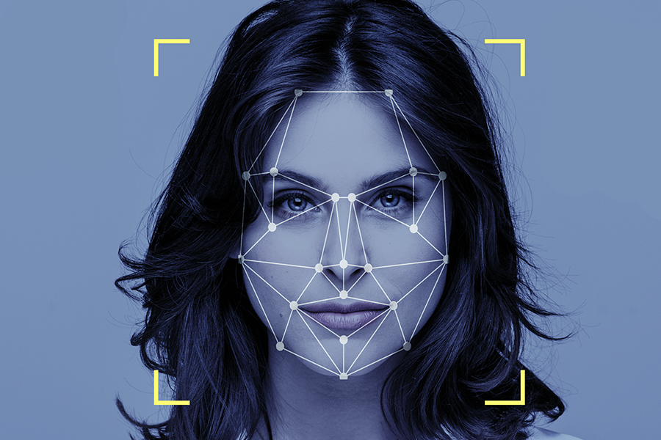

Slide 4
Background
SVM (Support Vector Machine) is a widely used machine learning algorithm that has shown to be effective in various classification tasks, including face recognition
SVMs are particularly useful for binary classification tasks, where the goal is to separate two classes of data points by finding an optimal hyperplane that maximally separates the two classes
The MTCNN algorithm is known for its high accuracy in detecting faces of various sizes and orientations
FaceNet model can extract high-dimensional feature vectors that can distinguish between individuals with high accuracy
The proposed system has been extensively studied and has shown to achieve high accuracy and efficiency in facial recognition, making it suitable for various applications such as access control, surveillance, and personal identification

Slide 5
Method and materials
We have used MTCNN for face detection which detected and recognised images from the dataset, along with FaceNet for facial recognition which identified who the face belongs to and SVM for classification of images
MTCNN and FaceNet were used together for facial recognition
The dataset was of 761 MB, divided into two folders, one of which contained the original images and the other had faces of celebrities
First, we collected and preprocessed the data, then we trained the MTCNN and FaceNet models, and lastly the SVM model

Slide 6
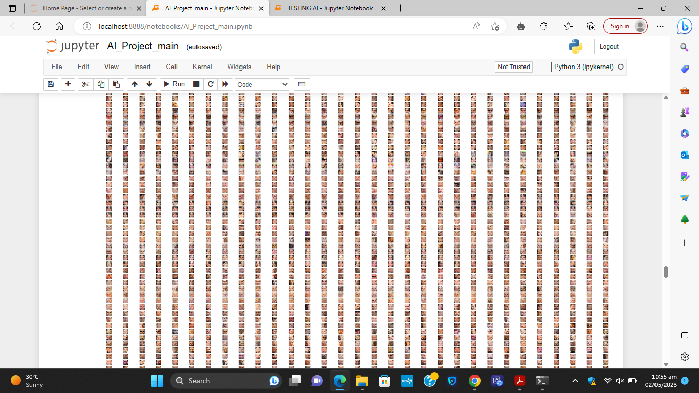
Data and results
Our dataset consisted of 761MB, and 5000 pictures.
All the images were loaded and the faces were detected:

Slide 7
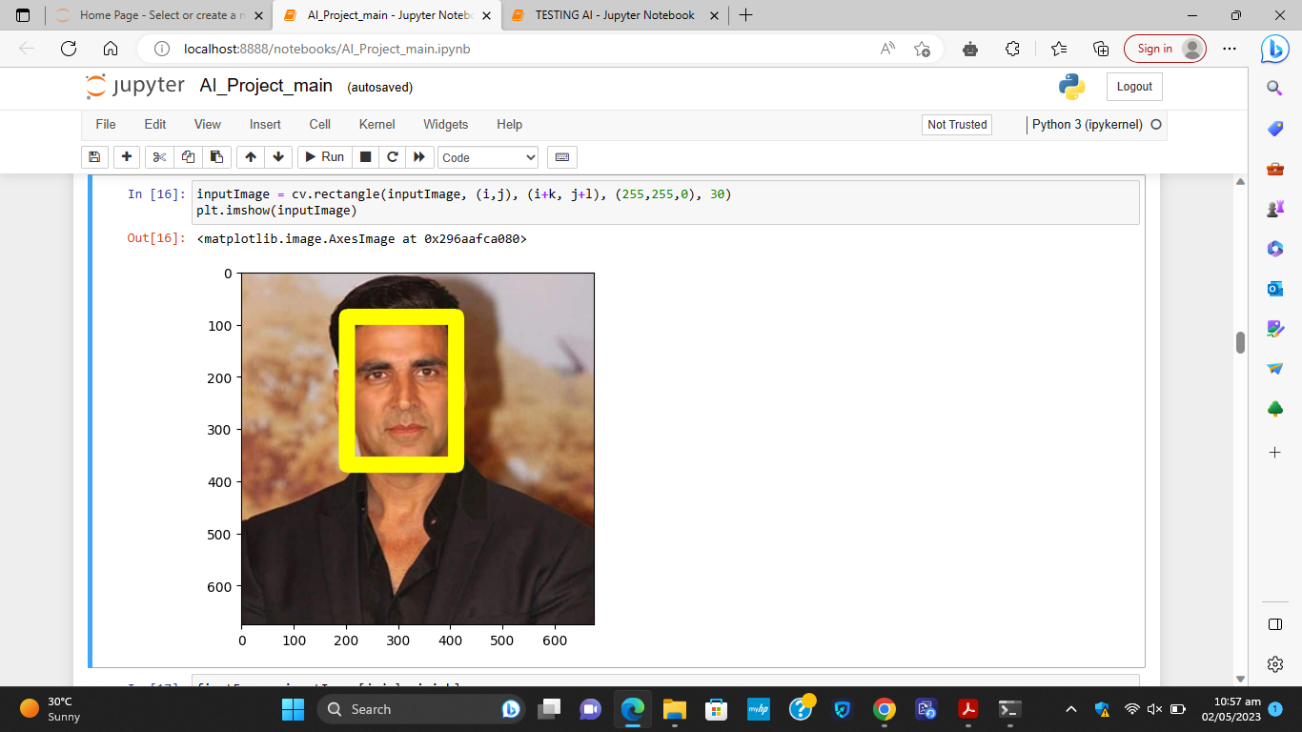
Each face was detected like this:

Slide 8
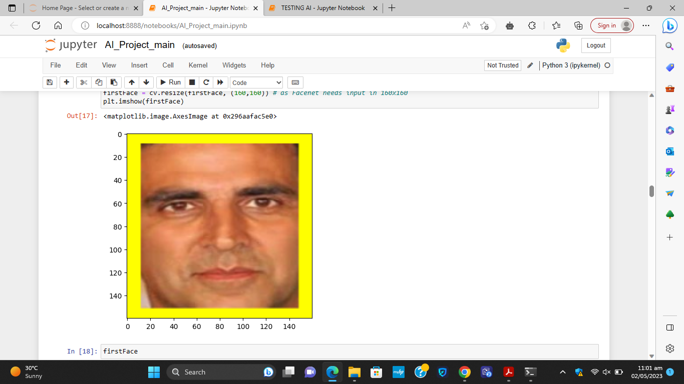

Slide 9

Then we tested our project using a new image of Akshay Kumar. You can see that it detected and recognised that it was the face of Akshay Kumar, as shown in the figures below:

Slide 10


Slide 11
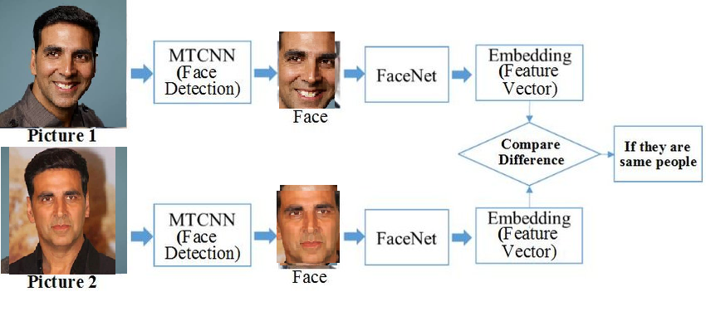

Slide 12
Conclusion
In conclusion, facial recognition using MTCNN, FaceNet, and SVM is a powerful approach for recognizing individuals in images with high accuracy
MTCNN helps to detect and align faces in images, FaceNet extracts high-quality feature embeddings from these faces, and SVM trains a model to classify the embeddings into the appropriate person
One limitation is that it requires a large amount of training data to achieve high accuracy, which may be difficult to obtain in certain applications
Additionally, facial recognition algorithms can be vulnerable to adversarial attacks, in which an attacker manipulates an image in a way that causes the algorithm to misclassify it
Overall, facial recognition using MTCNN, FaceNet, and SVM is a promising approach for recognizing individuals in images

Slide 13
